Slide 1
GROUP MEMBERS
Emmanuel Cadet (ecades@mum.edu)
Musiliu Adeniyi Bolaji (mabolaji@mum.edu)
Aaron Gezai (agezai@mum.edu)

Slide 2

Group One Library Framework
Introduction
In our previous MPP course we have developed a Library Management System and we have chosen two client applications to study in order to find duplication area so that we can put them into a common area which will be our Library Framework.
We have used several design patterns to abstract all area that can have general reusable solution and that can have an occurring problem

Slide 3
Patterns implemented.
When abstracting the common area we have been able to implement seven design pattern to build our Framework
Factory Method pattern
Strategy pattern
Façade pattern
Adapter pattern
Command pattern
Template Method Pattern
Singleton pattern

Slide 4
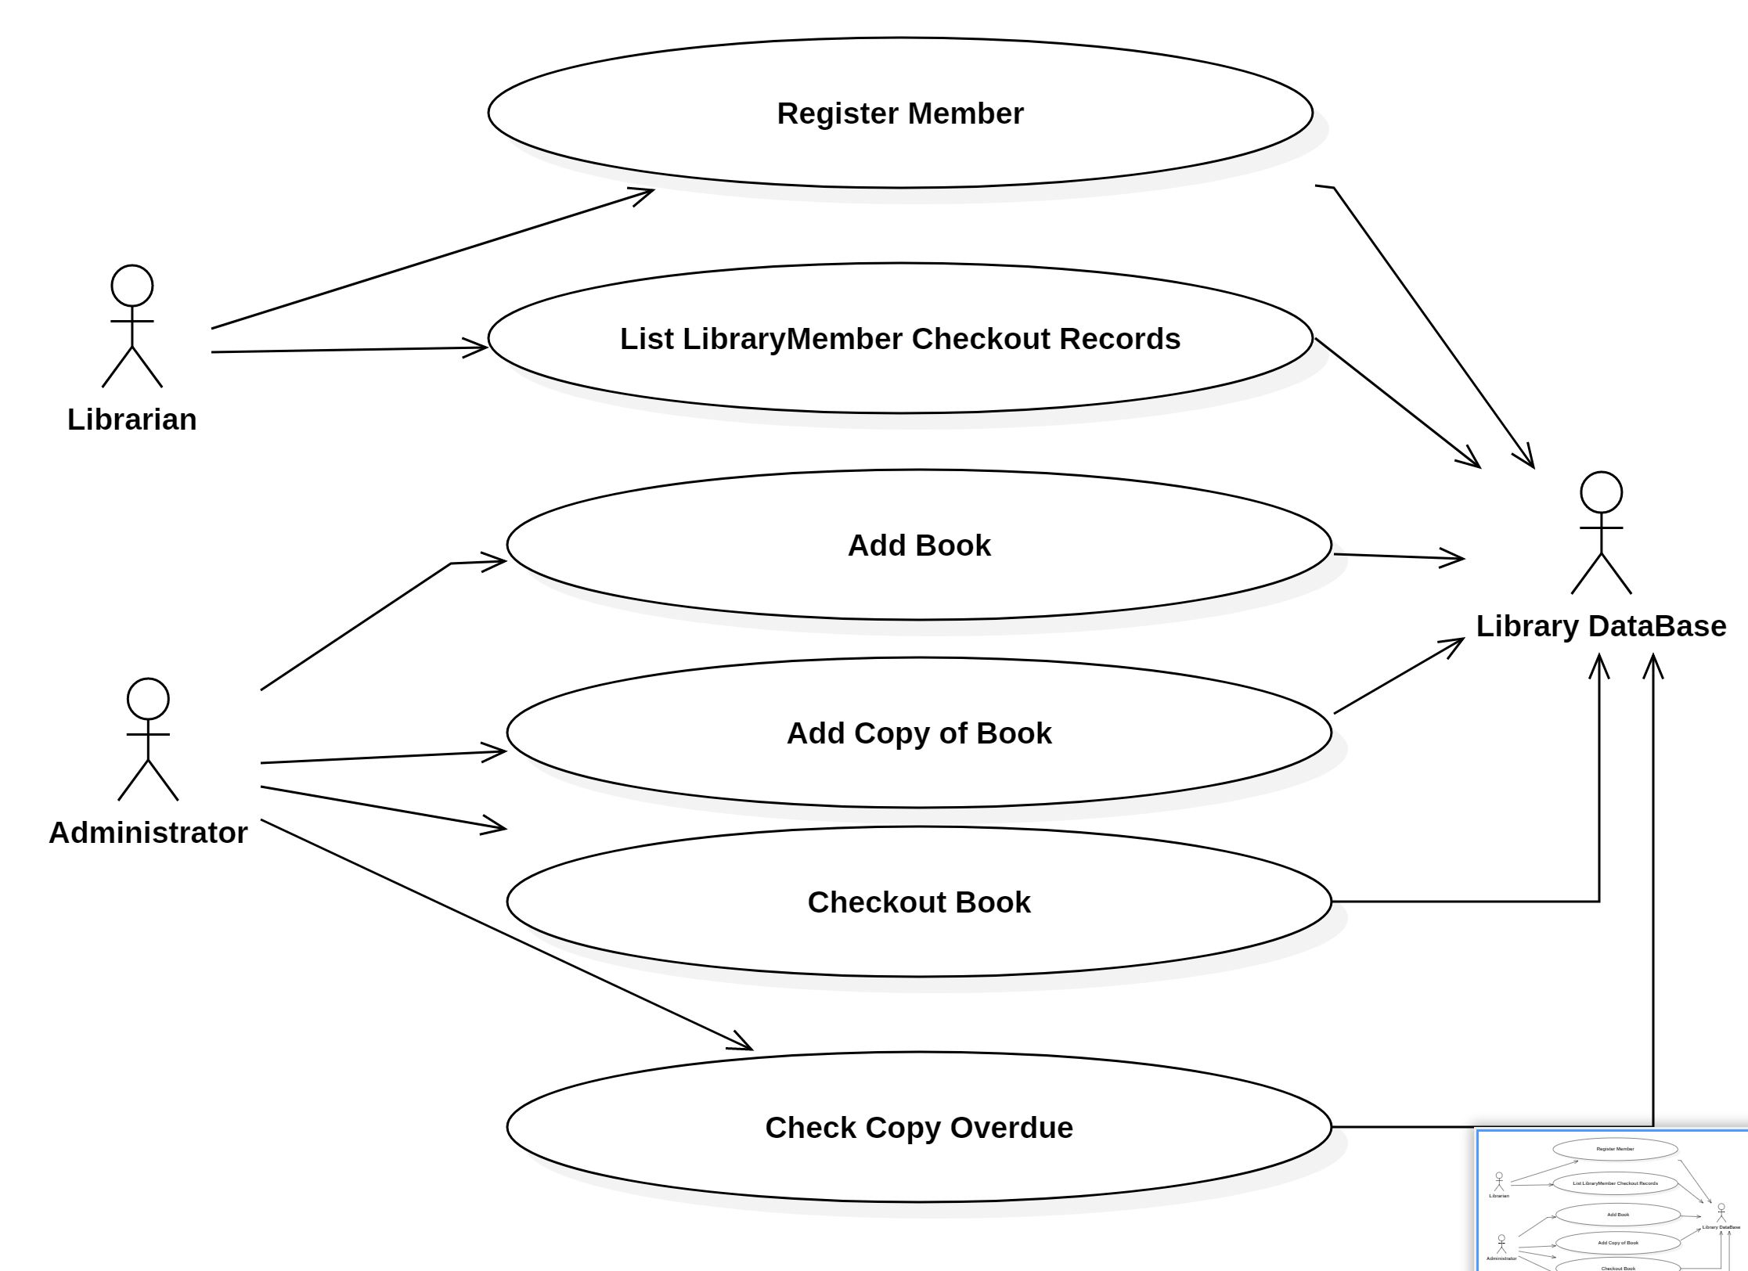
Library Management System Use Case Diagram

Slide 5
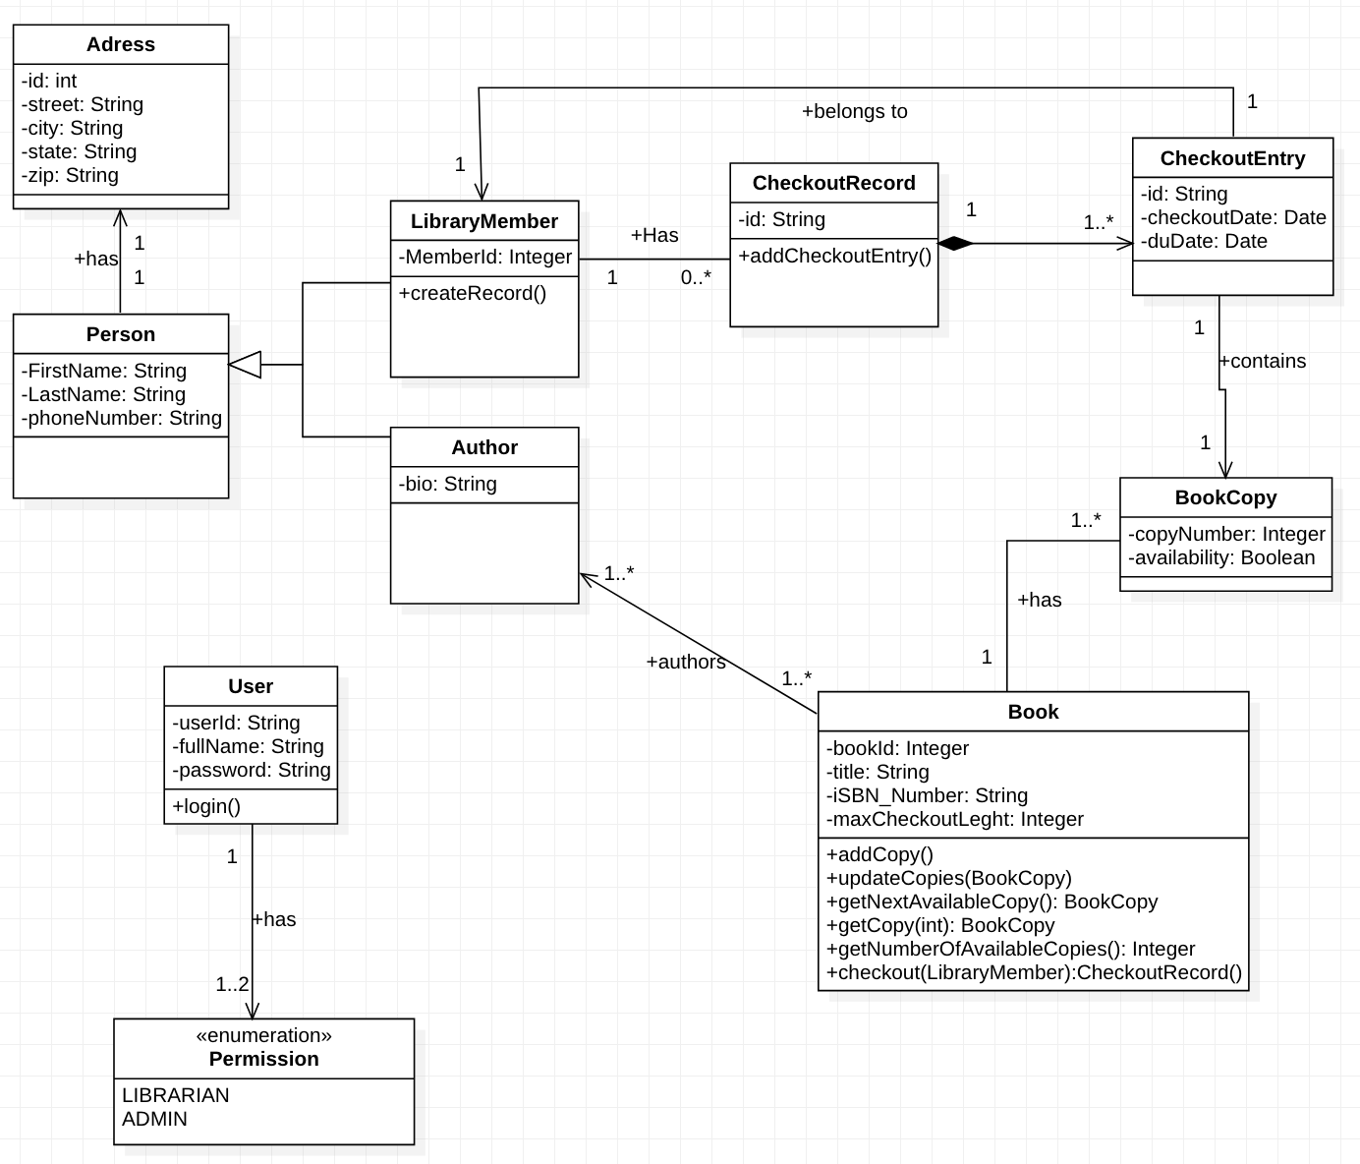
Library Management System Class Diagram
Class Diagram

Slide 6

MAIN KEY POINT OF OUR LIBRARY FRAMEWORK
The framework is developed to make Library Application development easy for application developers across different platforms.
The framework exposes four major APIs/services:
UserService – to manager users
BookService – to manage books
AuthorService – to manage authors
CheckOutService – to manage book checkouts
The developer can specify which and where to save records : Flat File or Relational Database

Slide 7
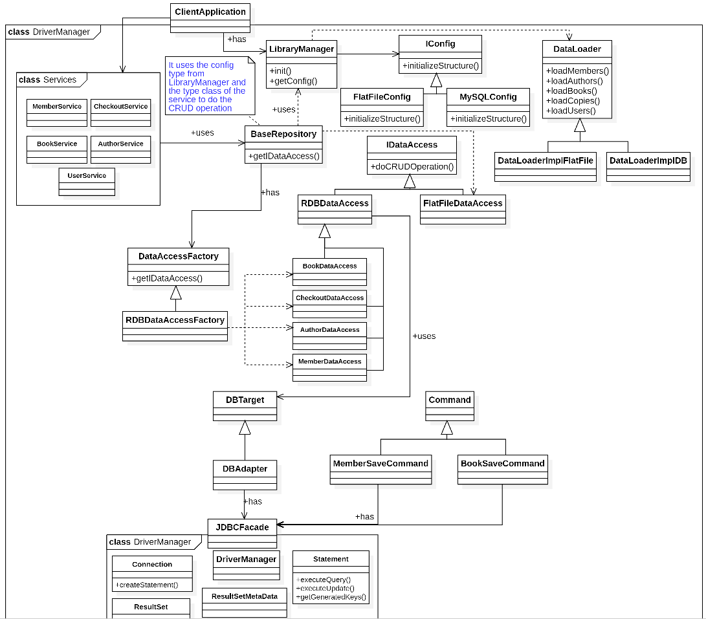
Library Framework Class Diagram
Notes:
THE FRAMEWOR DESIGN PATTERN

Slide 8
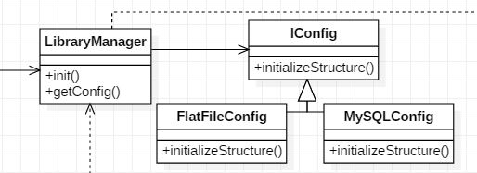
The Strategy Design Pattern
Client applications can use one of the entry point of the Library Framework which is the interface LibraryManager to choose either he wants to use Flat file or a MySQL database to store it’s data.
We have then implement a Strategy pattern to handle the variation of the type of storage the client want to use so that it can vary independently from him. The client can use a configuration file and base on his choice within the file the system will choose which storage type to use at runtime.

Slide 9
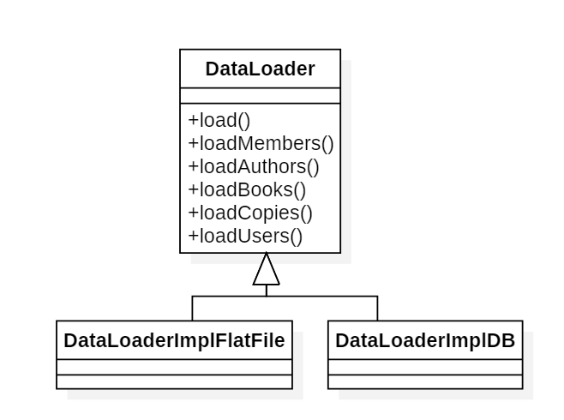
Template Method Design Pattern
We use the load template method to offer the client the possibility to load his personal data by implementing the abstract methods in DataLoader. Base on his need he may choose to implement some and leave the others.

Slide 10
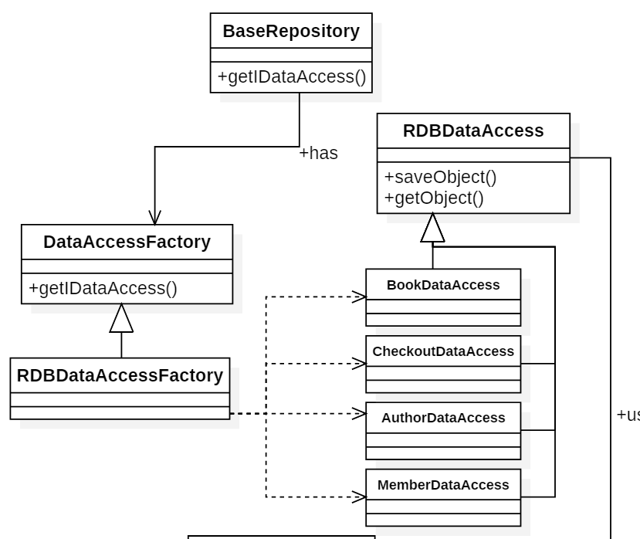
The Factory Design Pattern
In this area we use a Factory patter to create a data access object which may vary dependently on the type of service the BaseRepository interface need to store or get. The subclass RDBDataAccessFactory will decide which Data Access to create base on the type of the object that need to be stored. This solution is both reusable and easy to maintain.

Slide 11
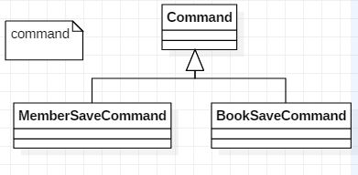
The Command Design pattern.
In our framework, we use this design pattern to handle save request for Members and Books. In fact, when we save a member, we have to save first his address in a separate table and after his information as a person and finally his information as a library member, if one fails at some point we do a rollback and eventually log them. Similar process for book.

Slide 12
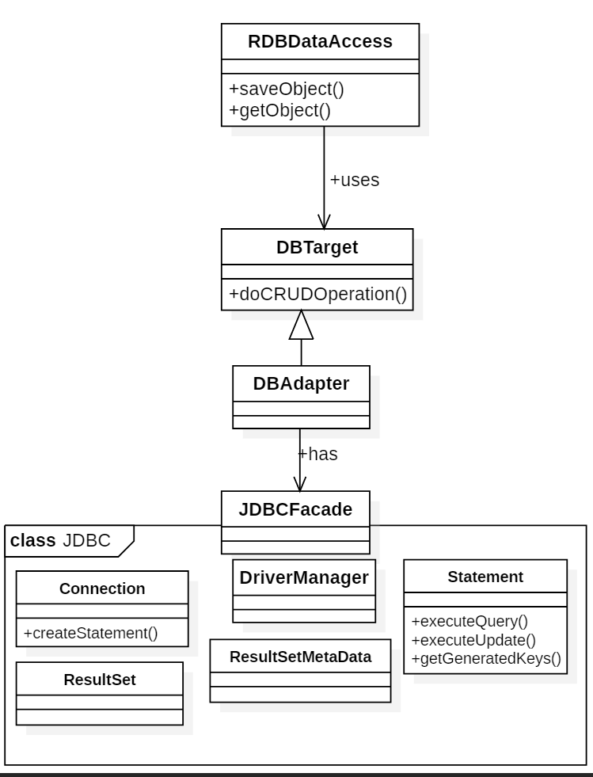
The Adapter Design Pattern
In this area, we use an adapter to provide a compatible interface to the RDBDataAccess concreate objects so that it can save the objects in the database properly.
Th adapter is needed here because the JDBCFacade interface only provide interface to send queries to the JDBC system. The Adapter take the objects convert the requested operation into the a query and use the Façade interface to send it to the database.

Slide 13
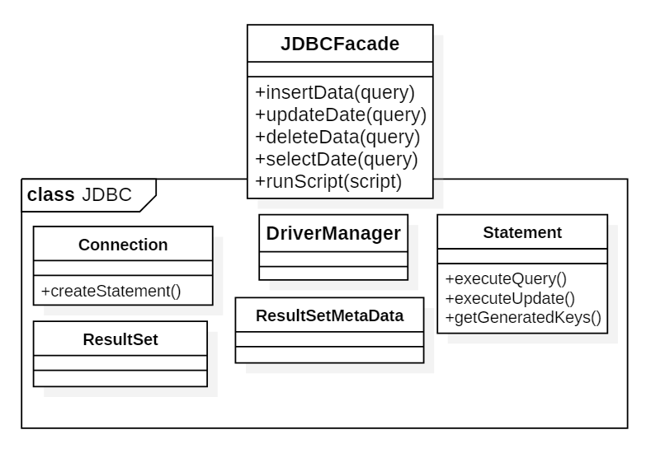
The Façade Design Pattern
The Façade pattern is used to hide all implementation needed to use the JDBC interface. It provides all necessary method to send a query to the database.

Slide 14
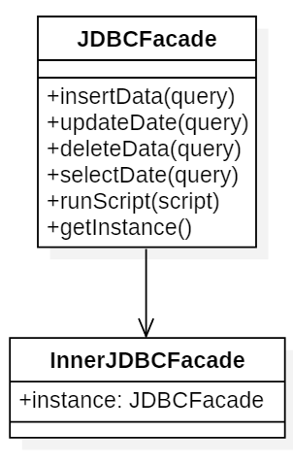
Singleton Design pattern
We use the singleton patter in the JDBCFace to provide a lazy instantiation and thread safe instance of it.
In this solution, the singleton instance is created inside an inner class and the inner class will be loaded only when the first call of the getInstance is made. This guaranty that the instance will be created when needed and as it is a private static instance which is initialized when it was declared it also guaranty thread safety. This solution is not only thread safe but it does not require any synchronization, then it is better then the first one.

Slide 15


